Slide 1



Air Purifier
Yap Song Lin (1823505)
Jayvien Ng (1822223)
Jia Nan

Slide 2

Background

Slide 3
Purpose
Our main goal for this project is to design a low cost & effective air purifier so that users from all walks of life can enjoy a better air quality.

Slide 4
Components
Button
Dust Sensor
Filter
LED & LCD
MQ2 Sensor & MQ135 Sensor
Temperature and Humidity Sensor
Wifi & Bluetooth Module (ESP-32)

Slide 5

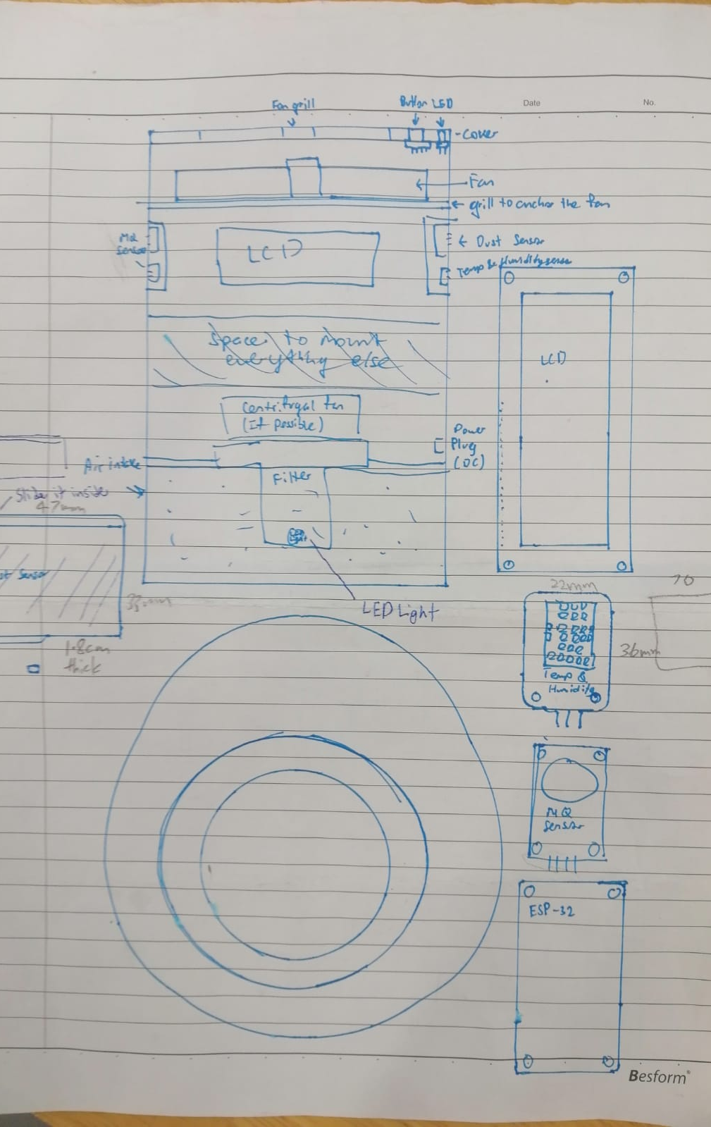
Sketches

Slide 6
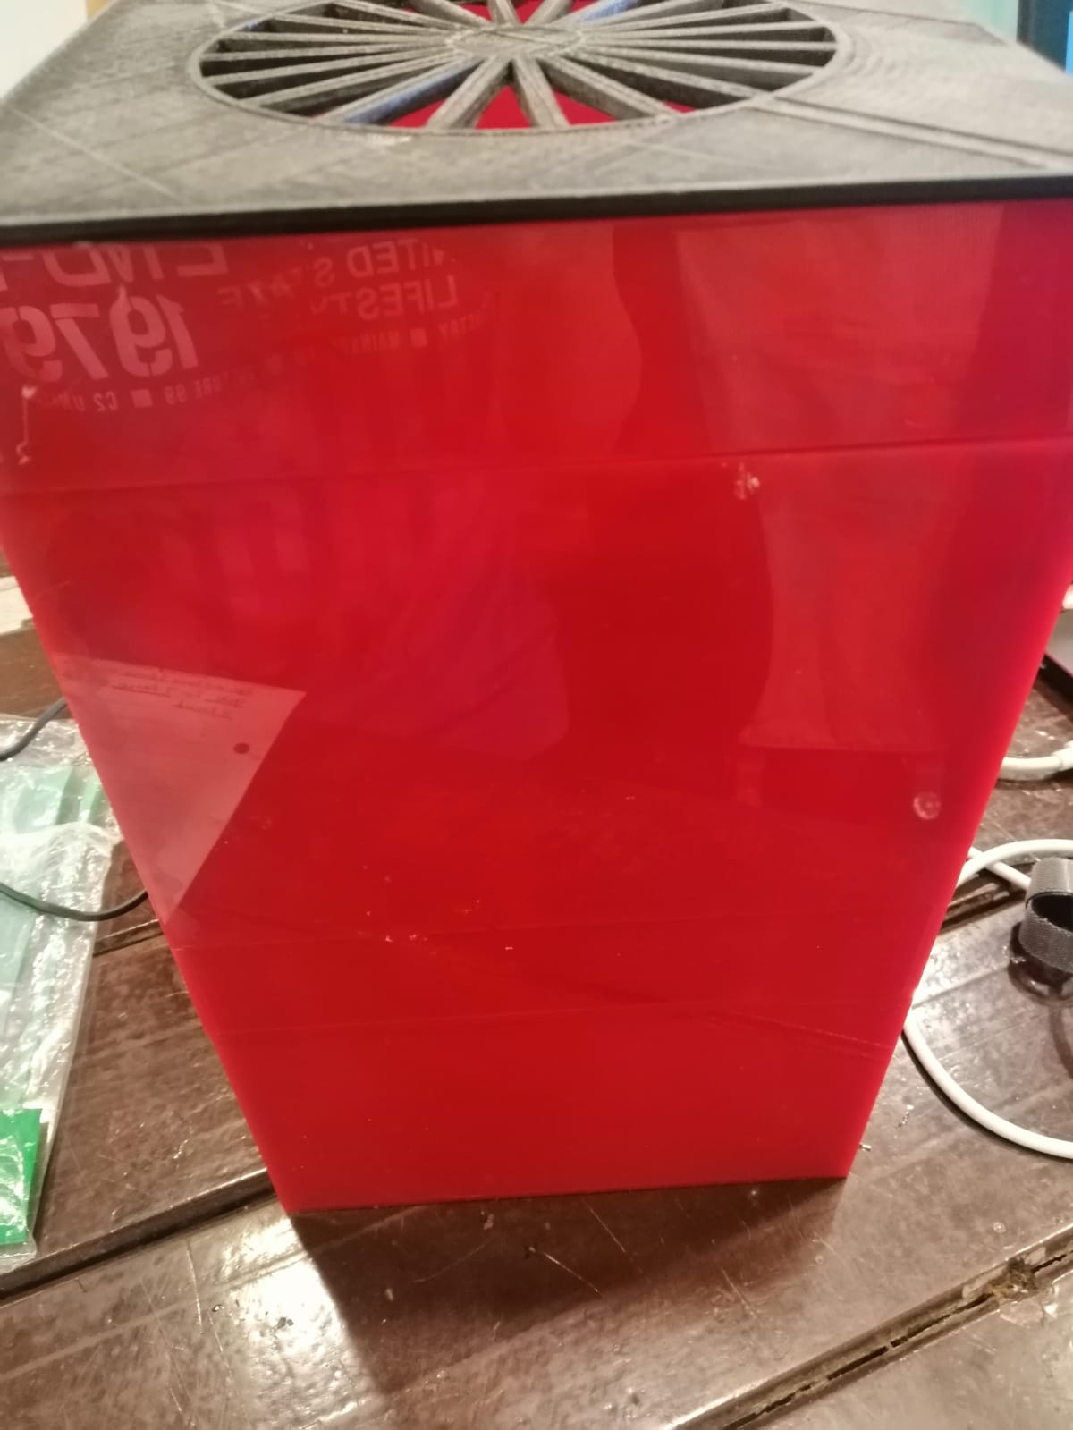
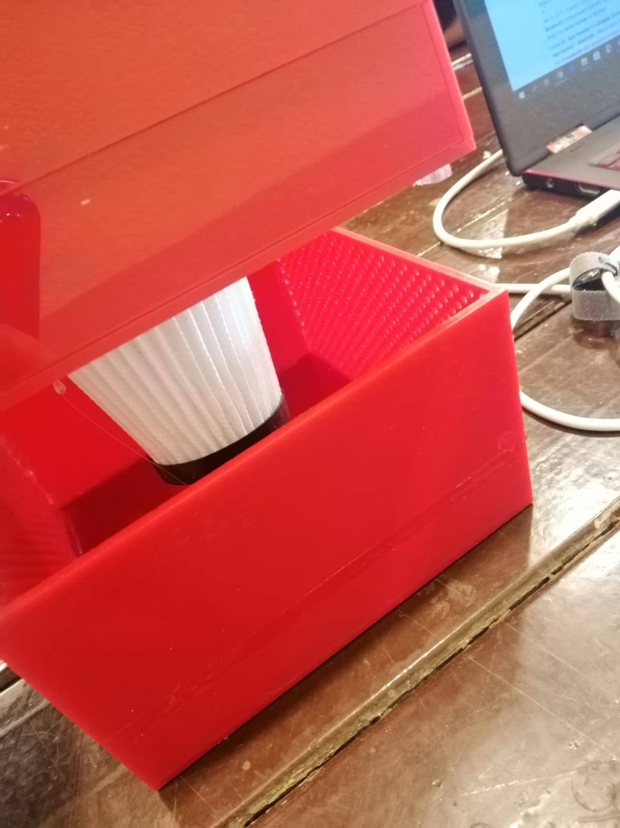
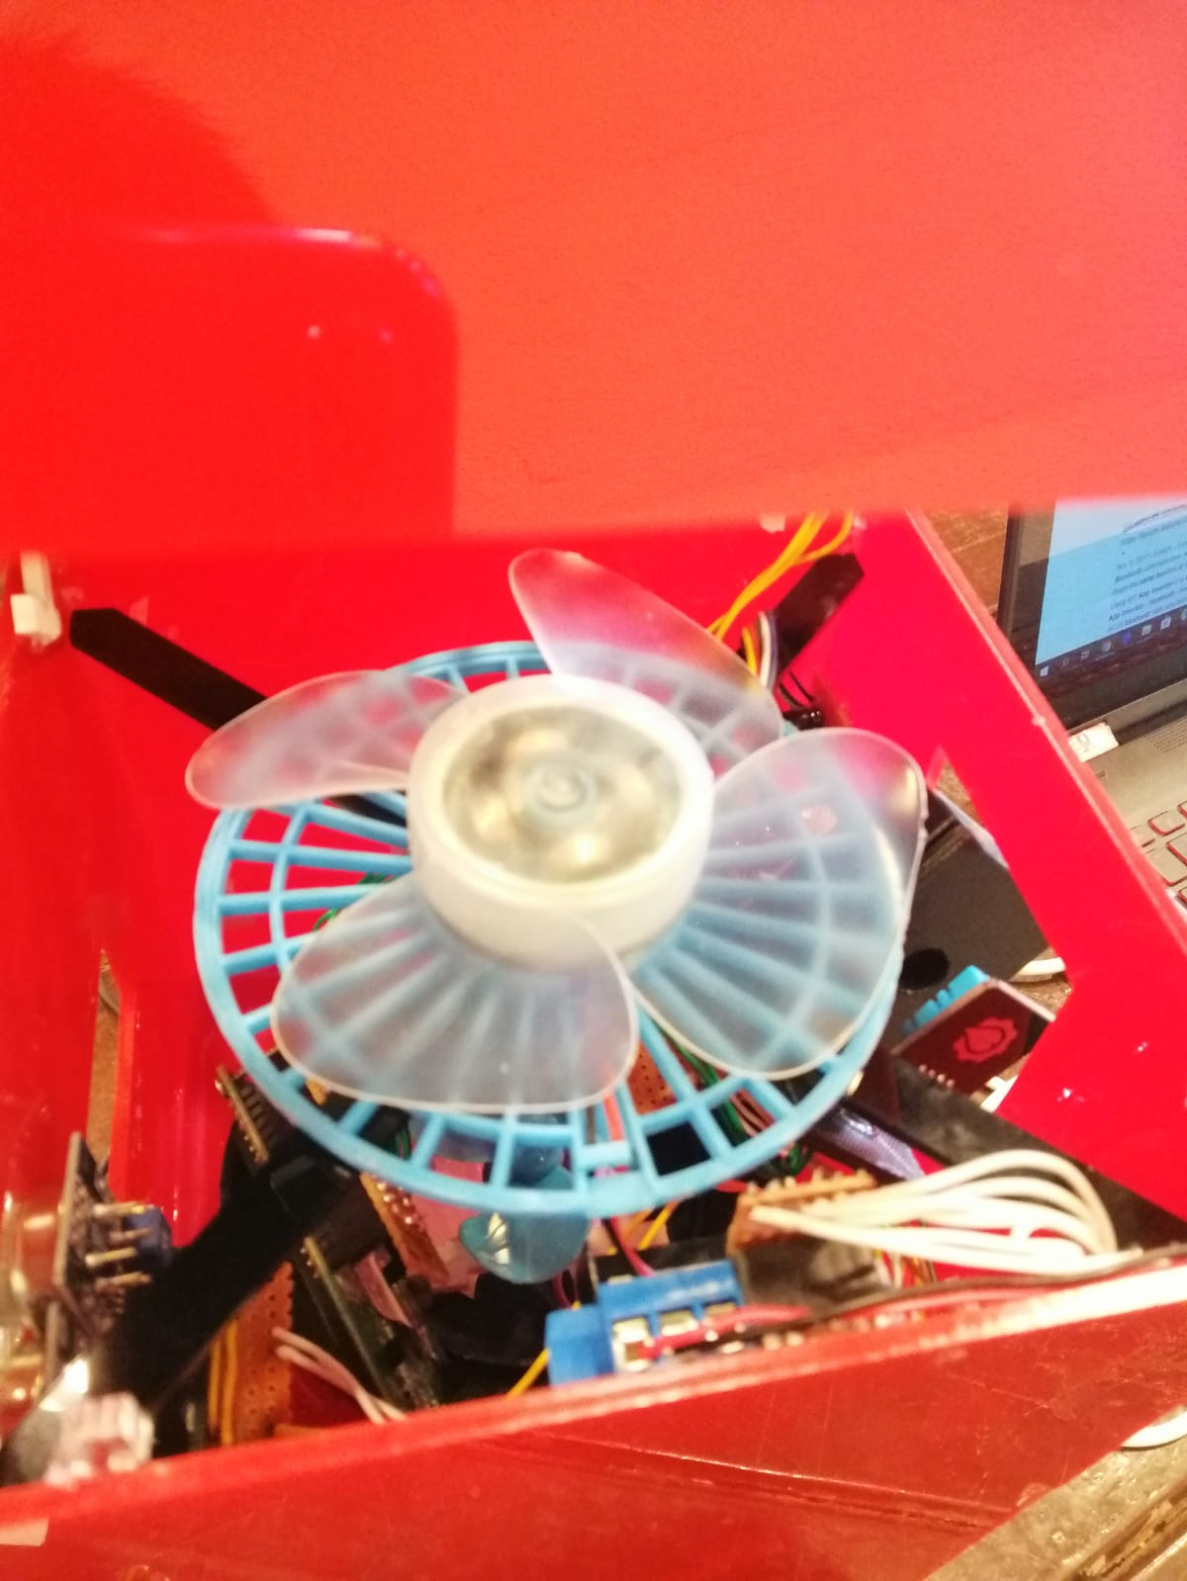
Parts
Bottom-Filter
Upper-Fan components
Finished Design

Slide 7
Features
This air purifier can be controlled by the user’s app so that they can on/off the air purifier
It contains sensors that can detect harmful gases

Slide 8

Further Improvement
Adding more features
Putting more space inside to allow better air flow

